Slide 1

Integrated Supply Chain Solutions
All Under One Roof
Developed At:
Samyak Infotech Pvt. Ltd
Developed By:
Kruti Raval
Guided By:
External Guide
Mr Sandeep Das
Project Manager
Samyak Infotech Pvt. Ltd
Internal Guide
Prof. Sandeep R. Suthar
Department of I.T
DD University
Faculty of Technology
Dharmsinh Desai University
April-2017

Slide 2
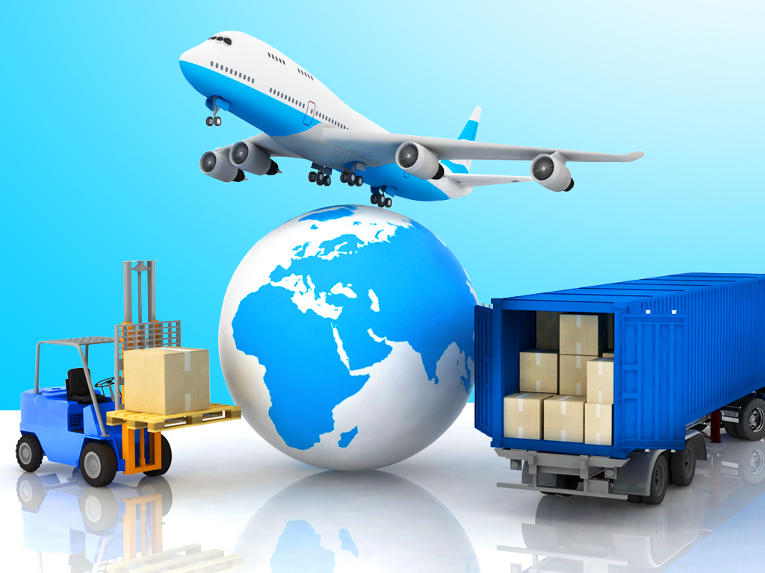
Integrated Solutions Across the Globe Network Global Logistics – (NGL)
Supply chain is the entire network of entities, directly or indirectly interlinked and interdependent in serving the same consumer or customer.

Slide 3
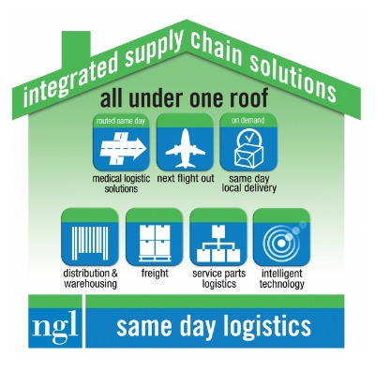
Definition
Supply Chain is Network of suppliers, distributors and subcontractors used by a manufacturer to source its raw materials, components and supplies.
Providing all the requirements of logistics under single roof.

Slide 4
Objective
To store, transport and distribute supplies and work-in-progress within the supply chain and distribute finished products to customers or intermediaries.
Provide mechanism to customers for order tracking
Provide efficient design for mission critical delivery and efficient distribution of freight and warehousing via a supply chain management solution.
To improve efficiency and reduces costs, increasing the manufacturer’s competitive advantage.

Slide 5
Current Product Scenario
Built on Microsoft’s Silverlight
Clumsy Design with Flaws
Works only in IE and Firefox

Slide 6
Why does it need a major update? The need to shift to other technology
Microsoft’s Silverlight is a deprecated application framework
Silverlight shutting down by 2020
Some functionalities not supported in Chrome, Opera

Slide 7

Solution
What changed and improved ?
AngularJS is lightweight, platform independent JavaScript framework with the best response time
Supported by almost all the leading browsers without the need of adding any extra plugin
Neat and clean UI
Data binding occurs not on each control or value change but at particular points of the JavaScript code execution. That dramatically improves performance as a single bulk Model/View update replaces hundreds of cascading data change events.

Slide 8
Hardware and Software Requirements
Client Side
Software
Browser
Microsoft Internet Explorer versions 8.0 or above
Mozilla Firefox 1.5 or above
Google Chrome
Safari

Slide 9
Hardware and Software Requirements
Server Side
Hardware
OS: Windows, Mac/IOS
RAM: 4GB
Hard Disk: 16GB
Software
Browser
SQL Server

Slide 10
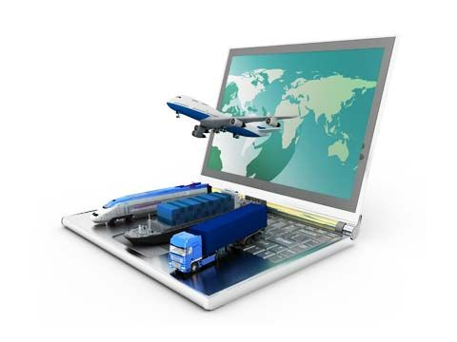
Technologies
AngularJS 1.4
ASP.NET
ASP.NET MVC
ASP.NET Web API
Microsoft SQL Server 2008
HTML
Jquery
C#
The technology stack:
HTML/CSS + jQuery UI + AngularJS + ASP.NET MVC + Web API + SQL Server

Slide 11
Functionalities
Customer
Services
Special Instruction
Outstanding Invoice
Courier
Service Area
Courier Delay
Airport
Alternate Airport

Slide 12
Functionalities
Customer
Department Info
Documents
Reference Configuration
Courier
Alerts
Airline
Locations
Inventory Profile
Cycle Count Configuration

Slide 13
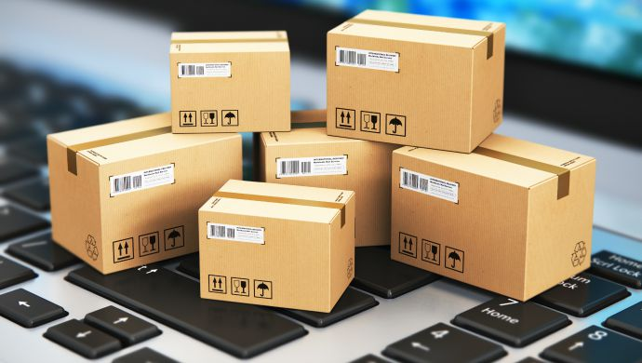
DIAGRAMS Courier

Slide 14
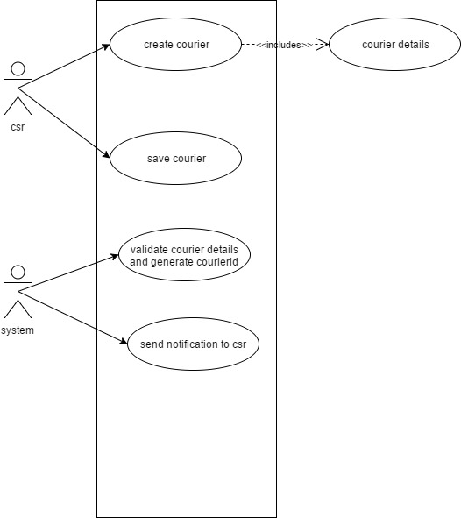
Usecase for courier creation

Slide 15
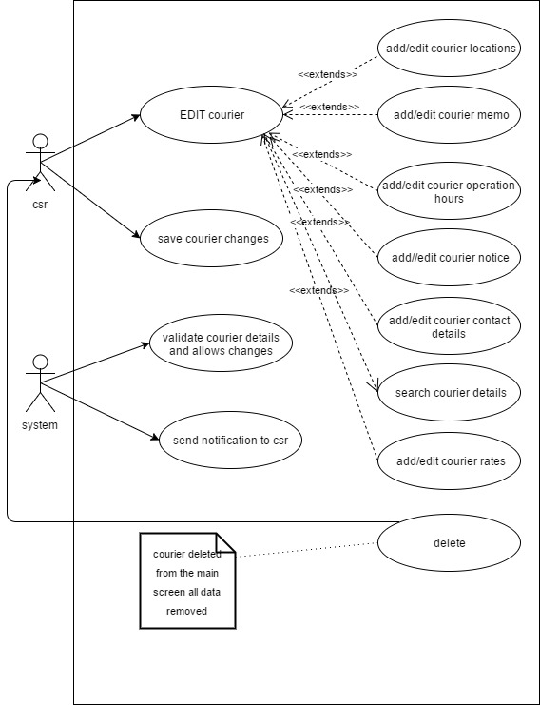
Usecase for Courier Modification

Slide 16
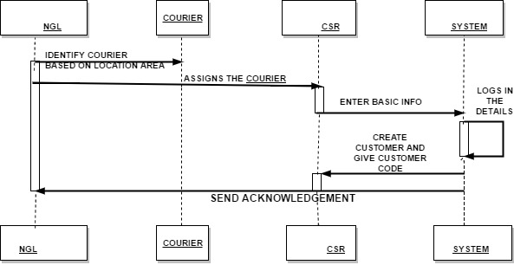
Sequence Diagram for Courier Creation

Slide 17
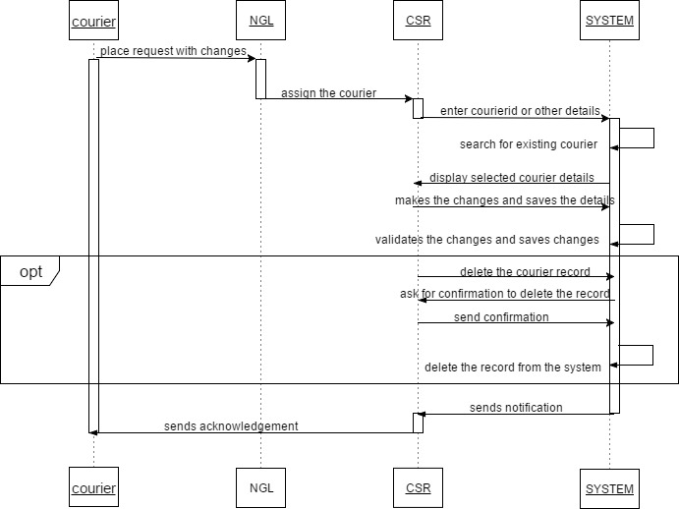
Sequence Diagram for Courier Modification

Slide 18
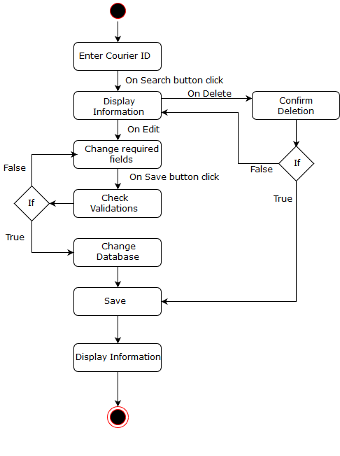
Activity diagram for courier Creation and Modification

Slide 19
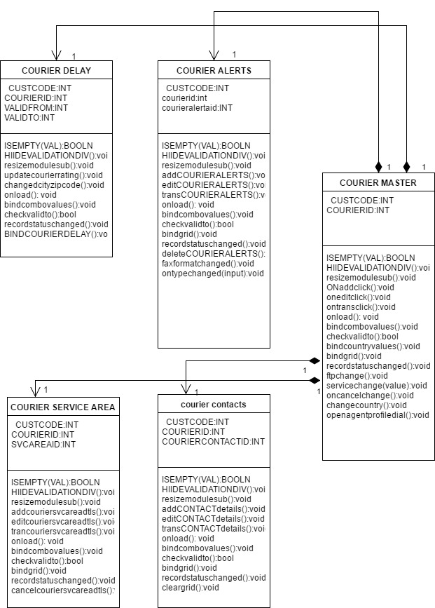
Courier Class Diagram

Slide 20
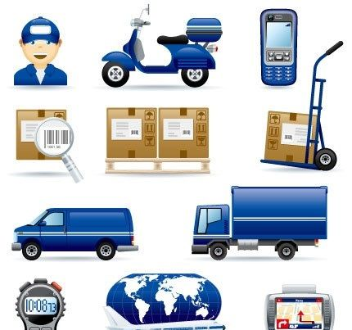
SCREENSHOTS

Slide 21

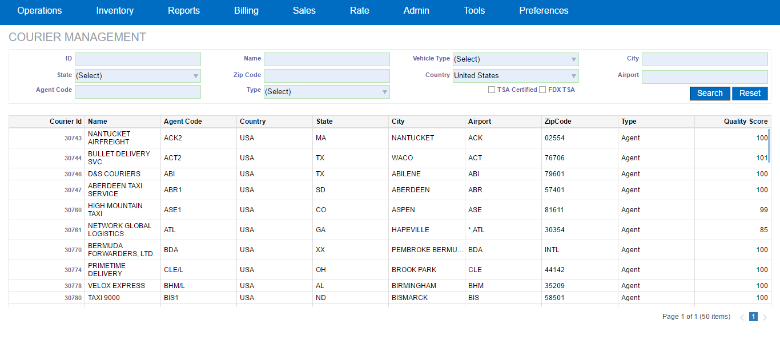
Courier Search

Slide 22
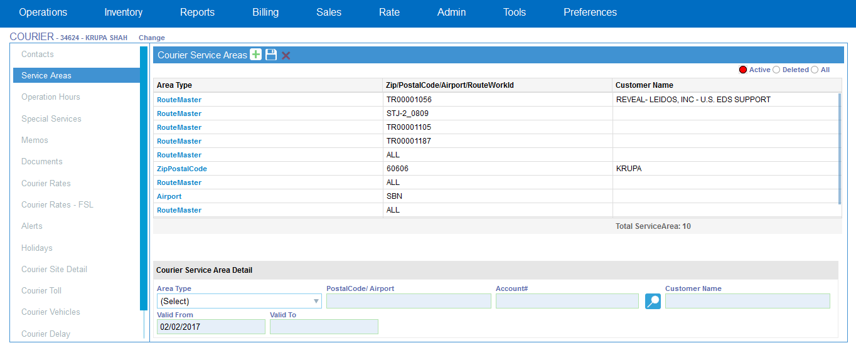
Courier Service Area

Slide 23
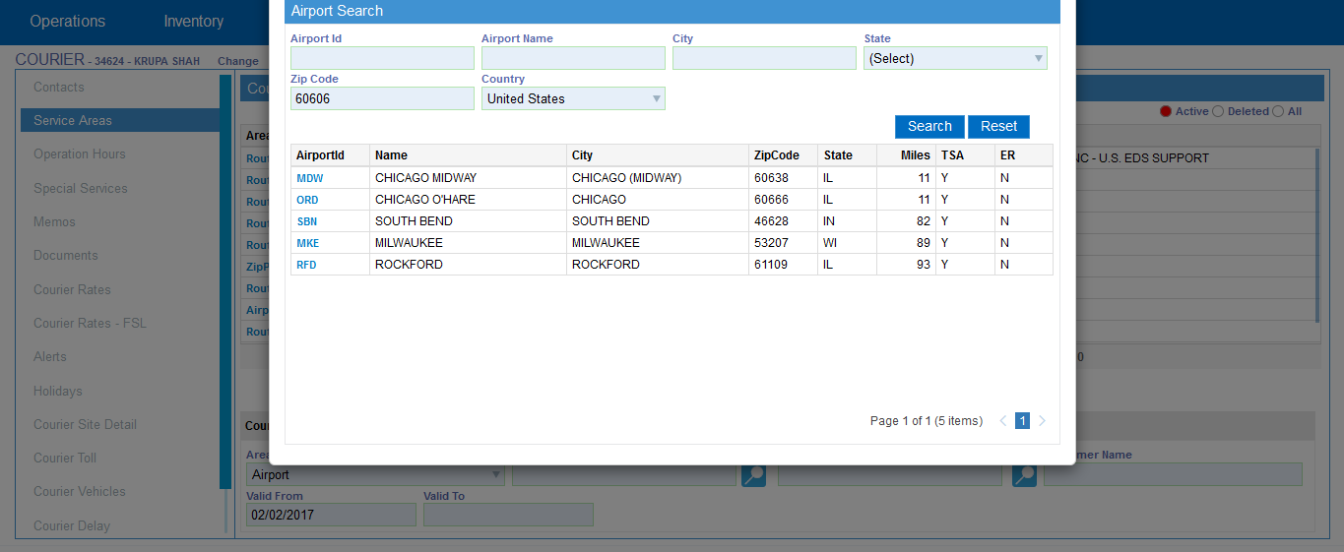
Service Area – Airport Pop-Up

Slide 24
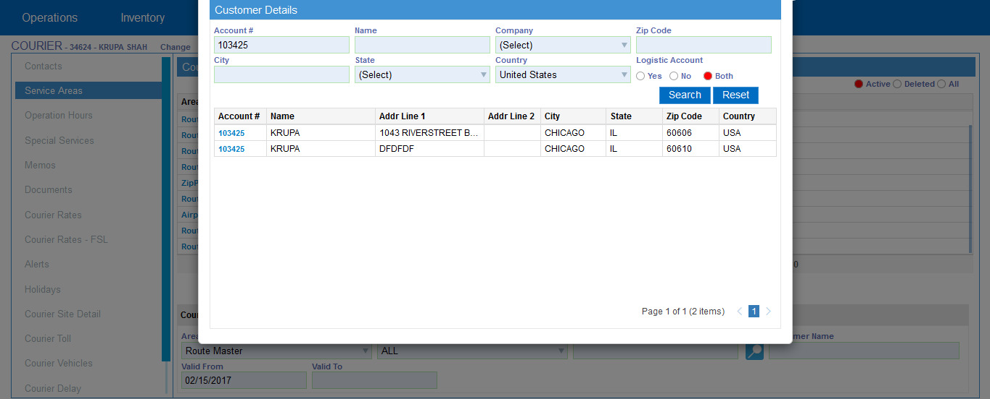
Service Area – Customer Pop-Up

Slide 25
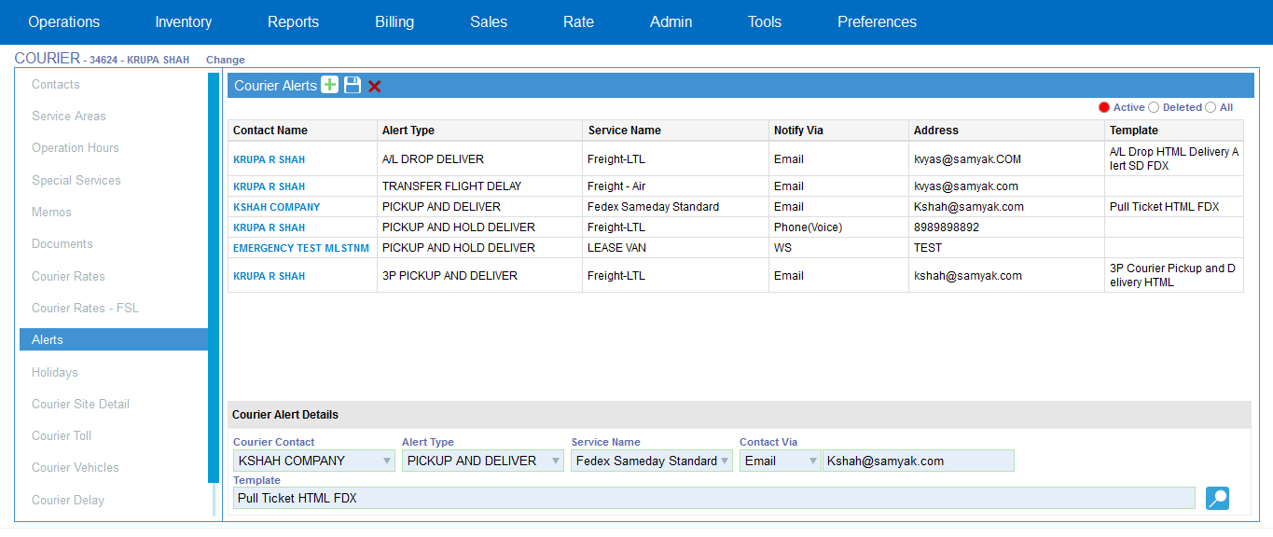
Courier Alerts

Slide 26
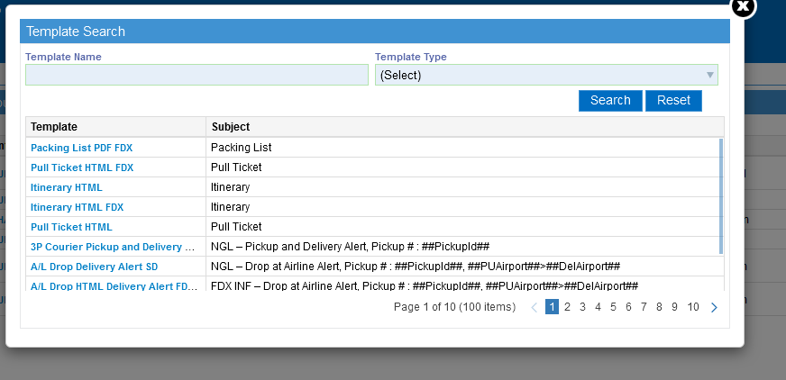
Alerts - Template Pop-Up

Slide 27
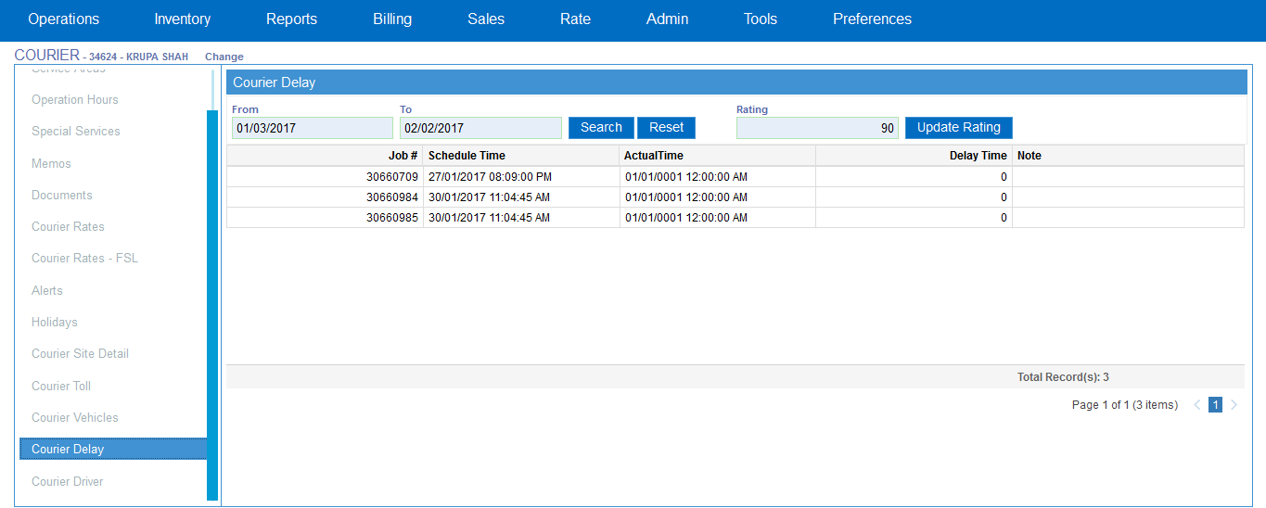
Courier Delay

Slide 28
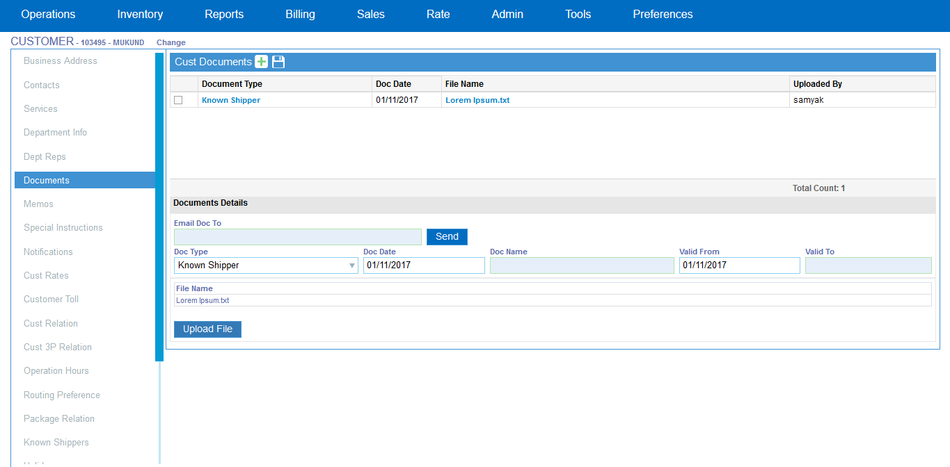
Customer-Documents

Slide 29
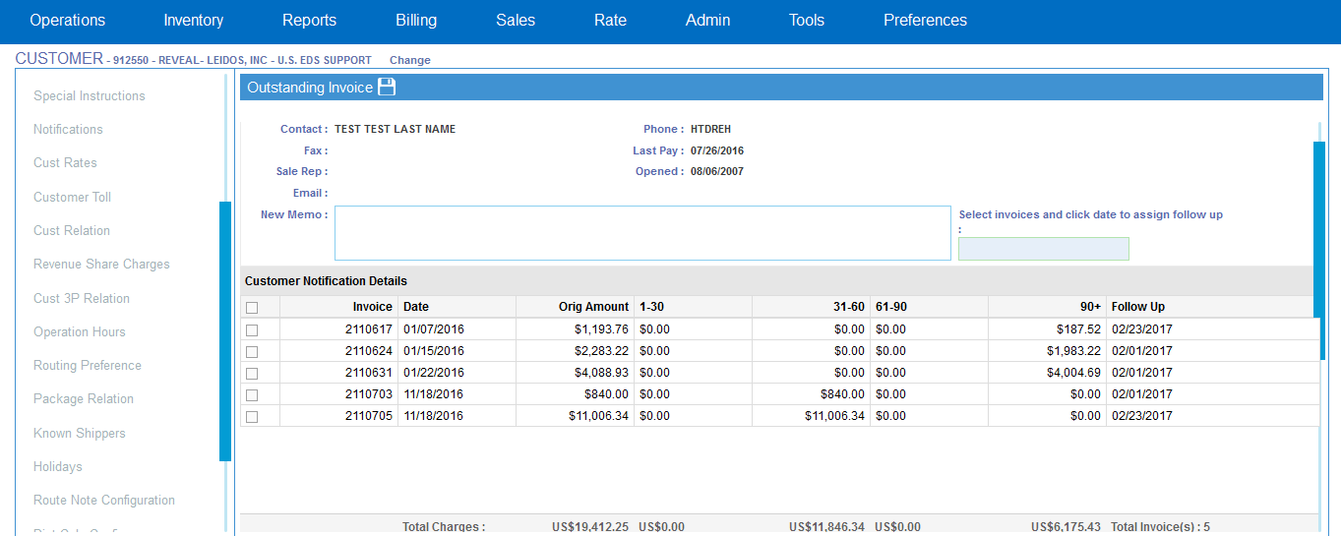
Customer-Outstanding Invoice

Slide 30
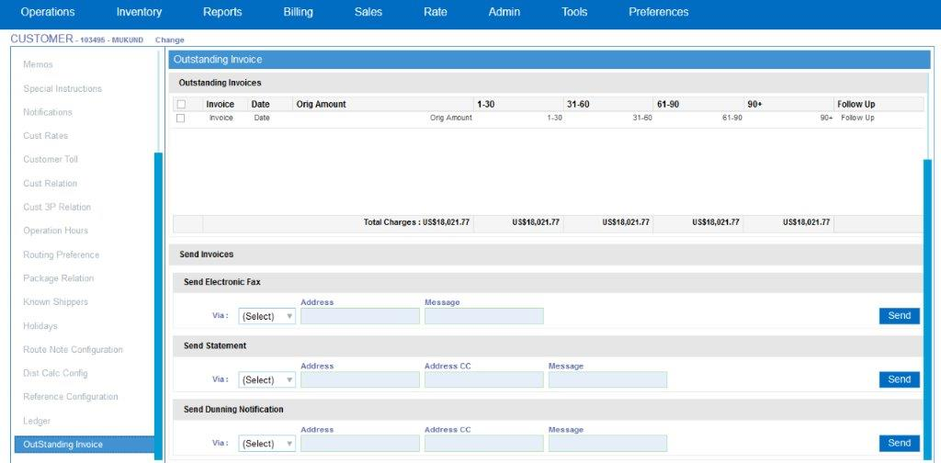
Outstanding Invoice – Send Notification

Slide 31
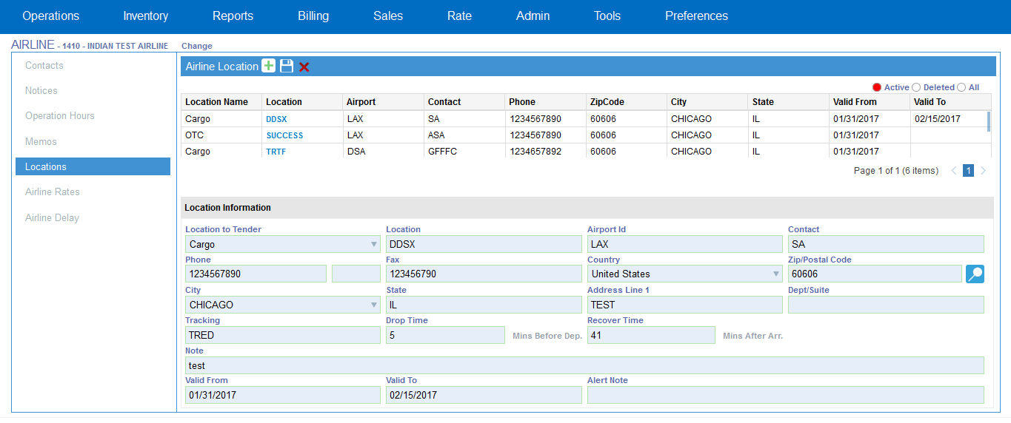
Airline-Locations

Slide 32
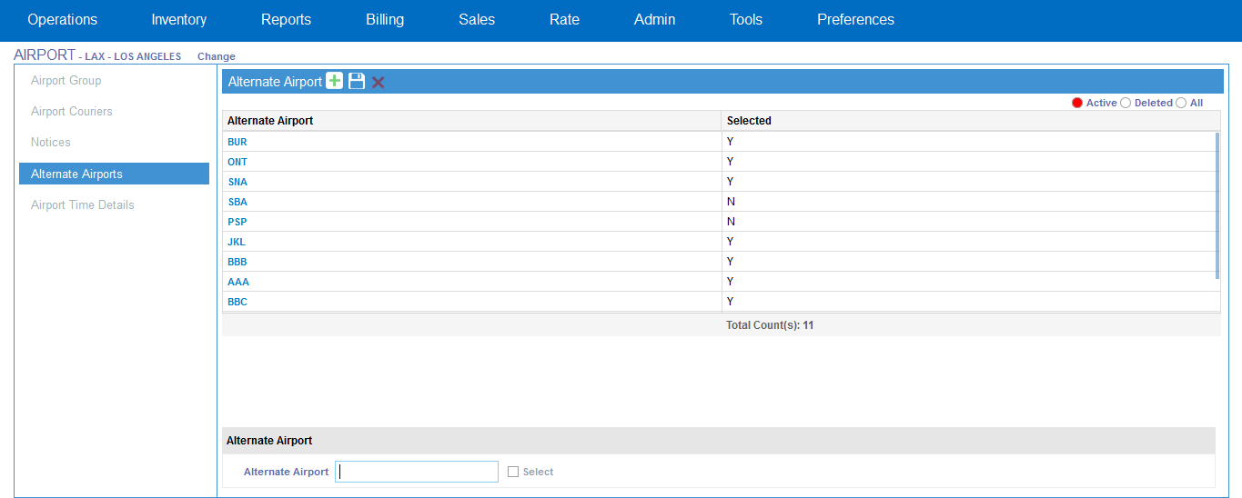
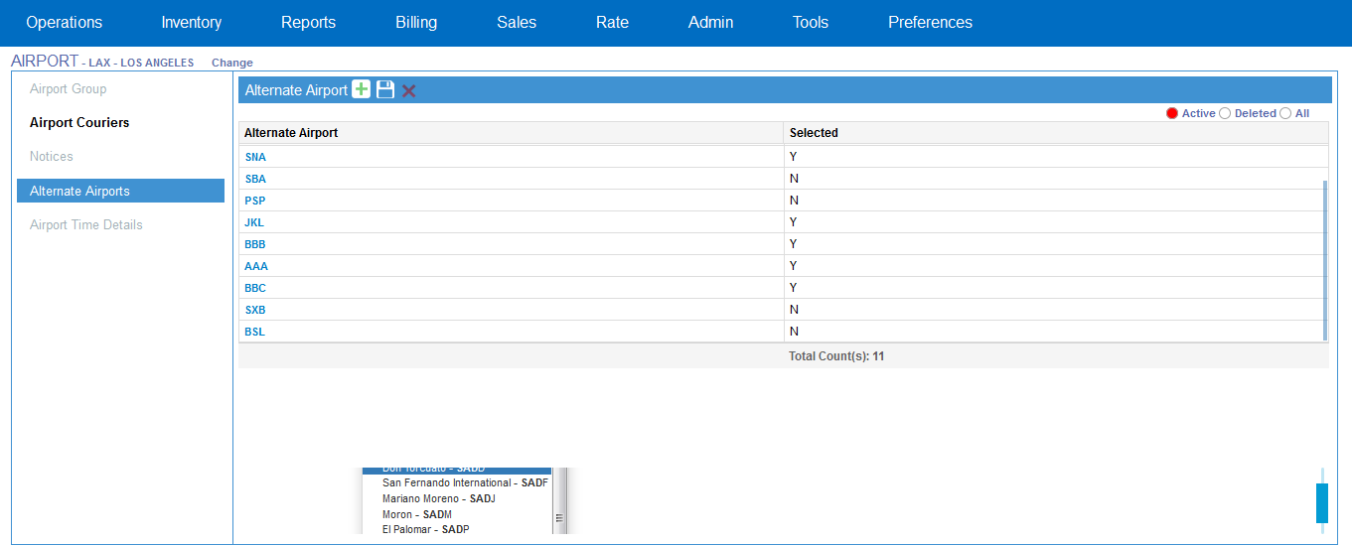
Alternate Airports

Slide 33
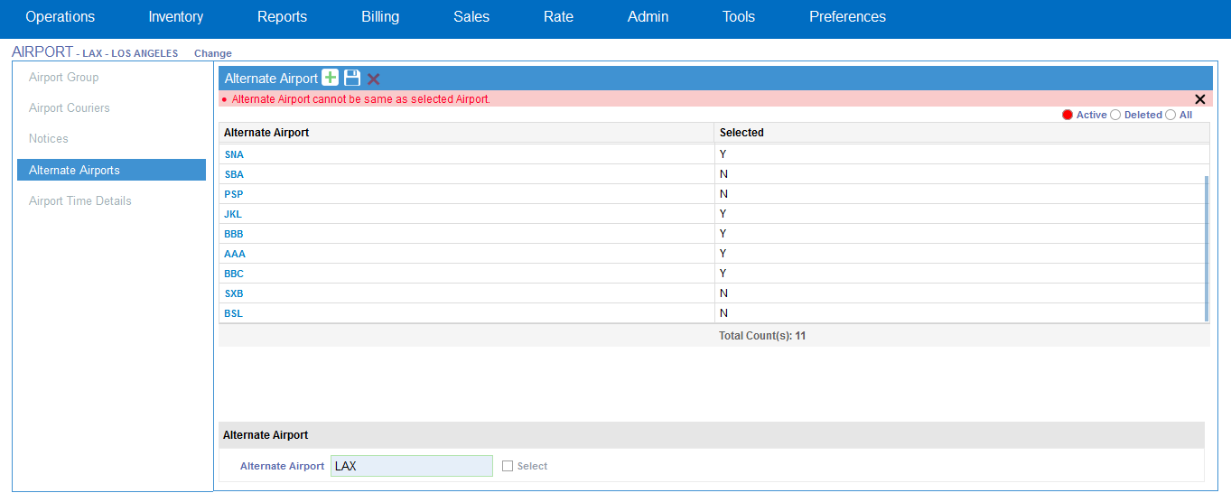
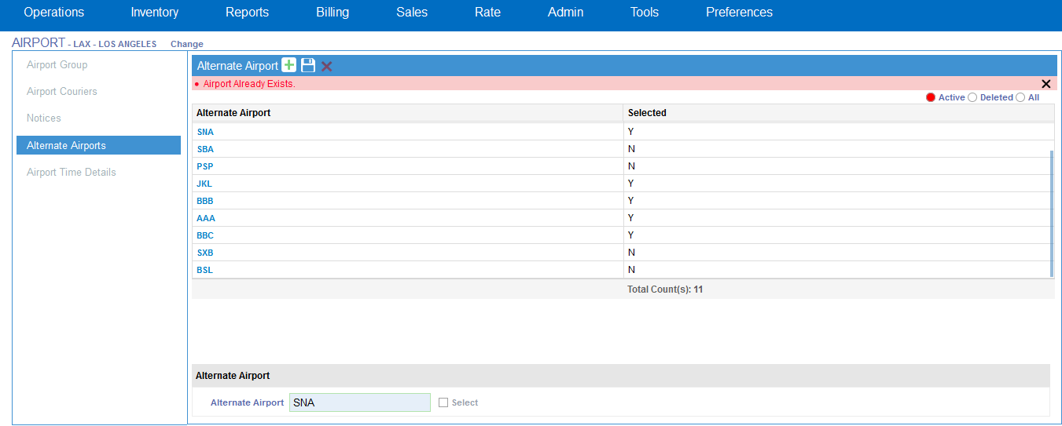
Alternate Airports - Validation

Slide 34
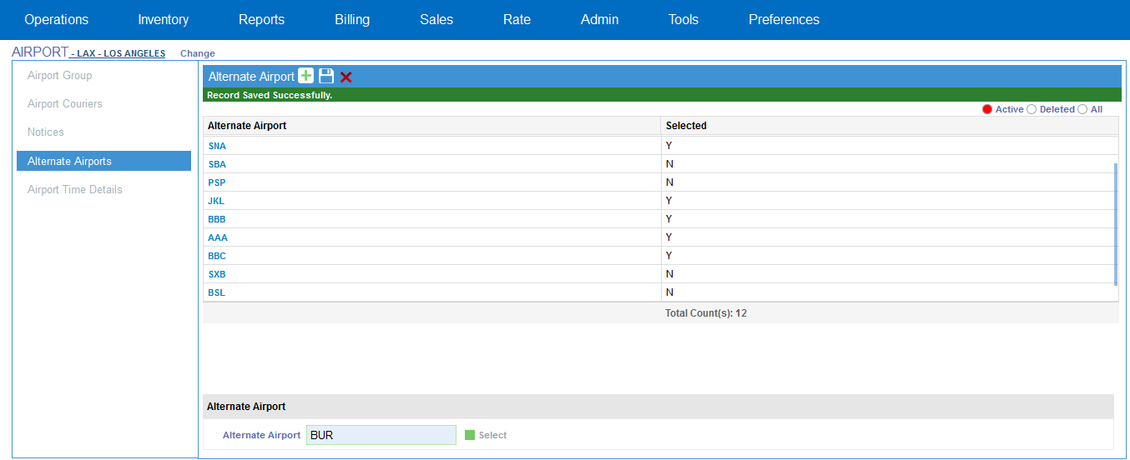
Validation - Record Saved Successfully

Slide 35
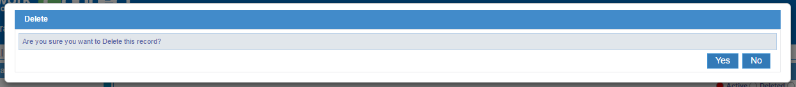
Delete Confirmation Pop-Up

Slide 36
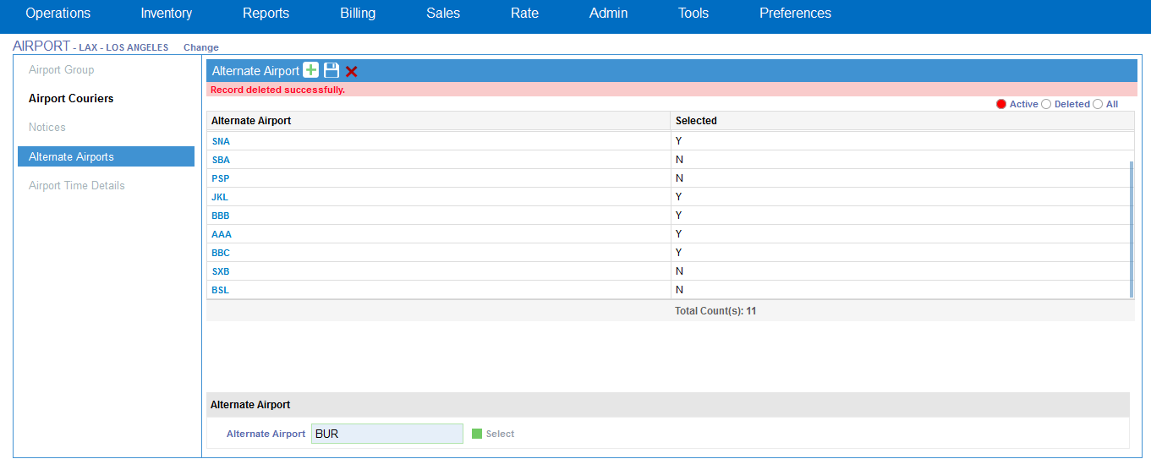
Validation - Record Deleted Successfully

Slide 37

Future Enhancements
FUTURE ENHANCEMENTS
UI design can be improved in such a way so that application can be opened in mobile browsers also.
Android and IOS apps can be prepared.
Converting the application to Angular 2 to increase mobile support.

Slide 38

Conclusion
Figuring out same day logistics and transportation can be a nightmare. It is
detail, time-consuming and costly. But with our IT infrastructure these hurdles
seem to be easily managed and handled.
Decrease in delivery failure
Minimize delays
Reduces uncertainty all along the chain
Quality of service goes up and costing goes down

Slide 39


